Slide 1


Machine Learning Project – Football Match Outcome Prediction
Using Machine Learning to Predict Match Results

Slide 2
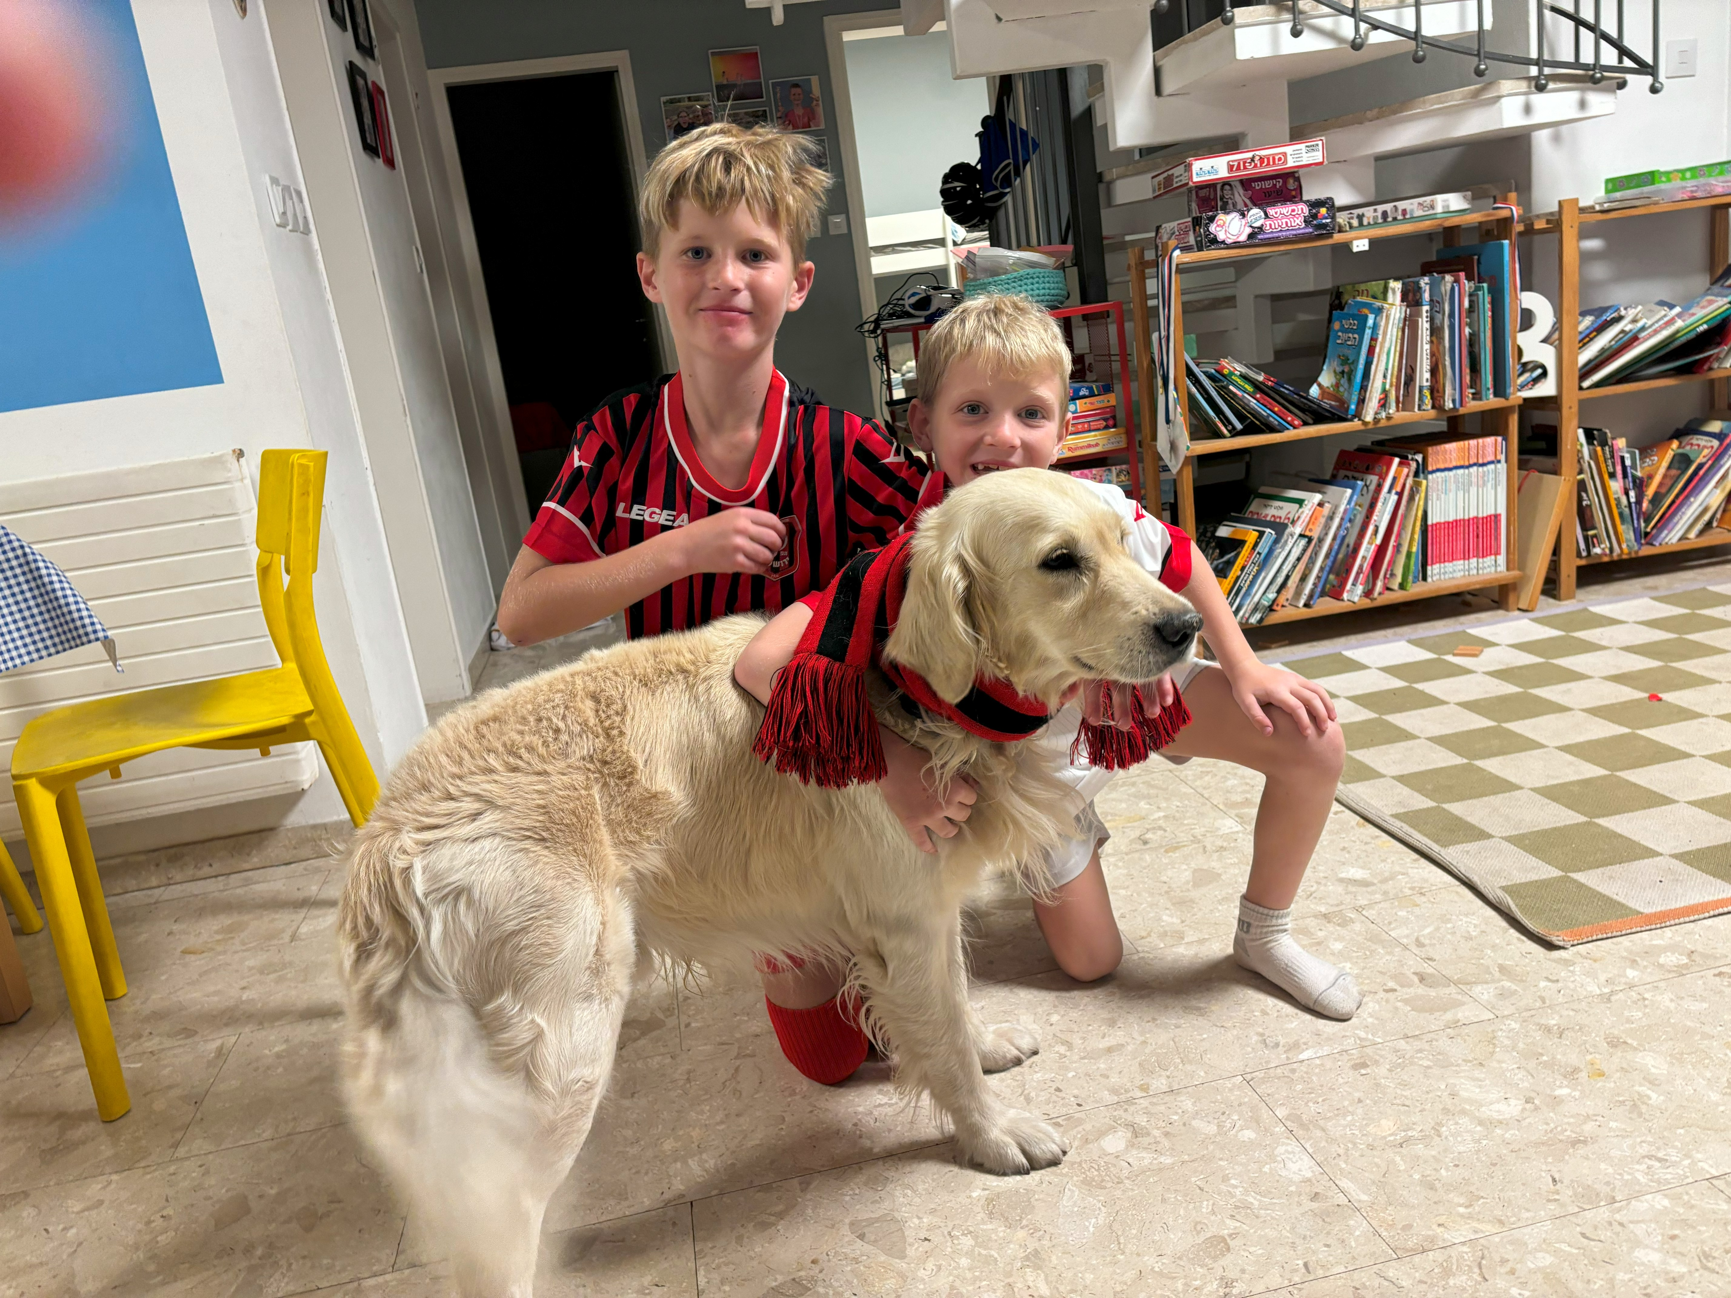
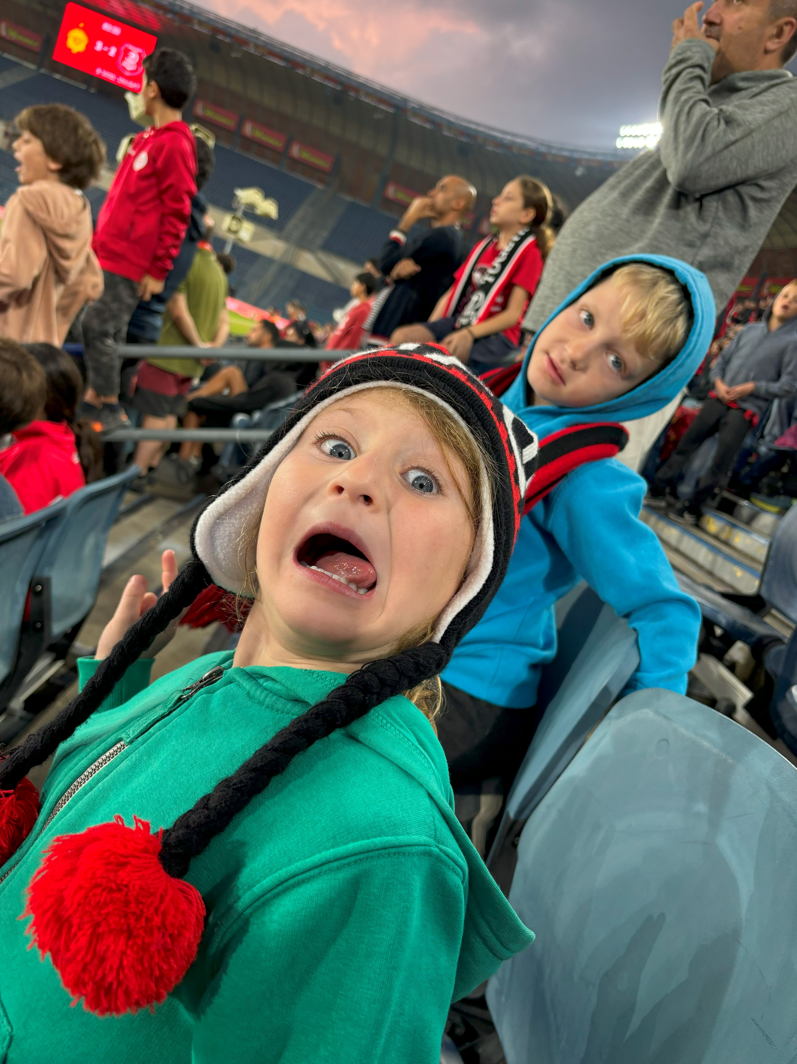

1. The importance of Football

Slide 3
2. The Data
Predict games result(home team)- Win, Lose or Draw
Dataset: games results from 2015 – 2020 (12,680 game records)
Useful for sports analytics and game predictions
The data Football Database <https://www.kaggle.com/datasets/technika148/football-database/data>
7 files ( appearance, games, leagues, players, shots, teams, teamstats)
3 main part – Players performance; Teams statistics ;Games statistics

Slide 4
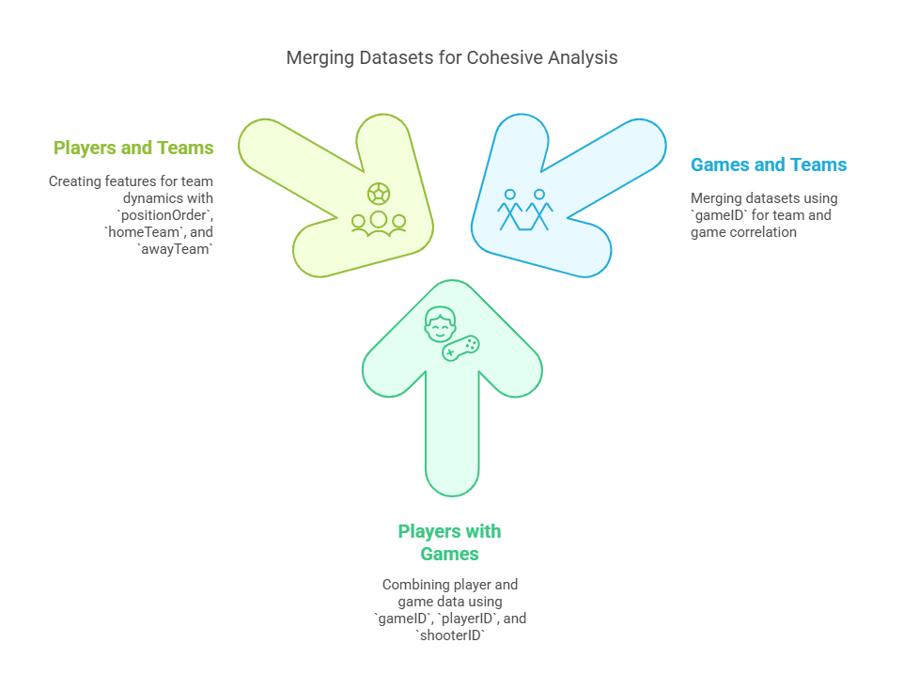
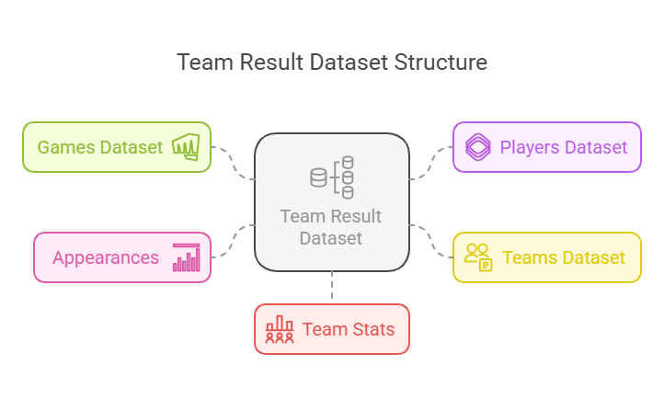
3. Data Preparation
Removed duplicate columns (columns of Goals, XG etx.)
Created Categorized columns (such as Goals 1-5 and 5+)
Encoded target variable as numerical labels (Win=1, Draw=0, Loss=2)

Slide 5
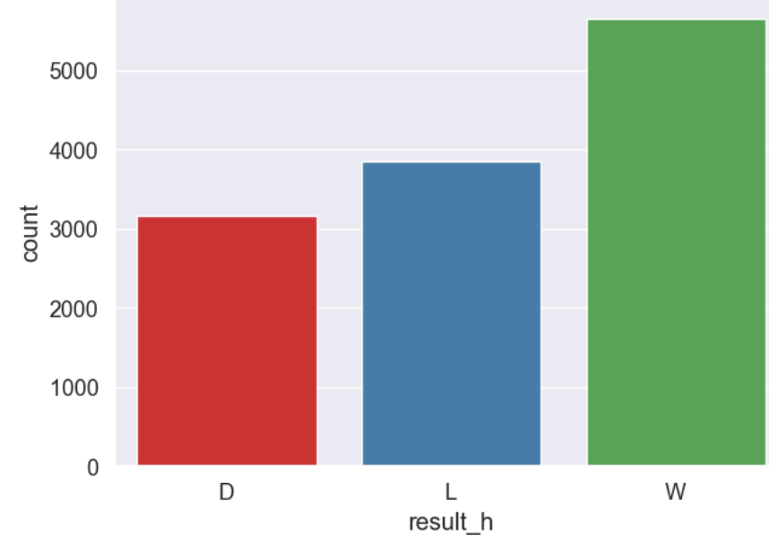
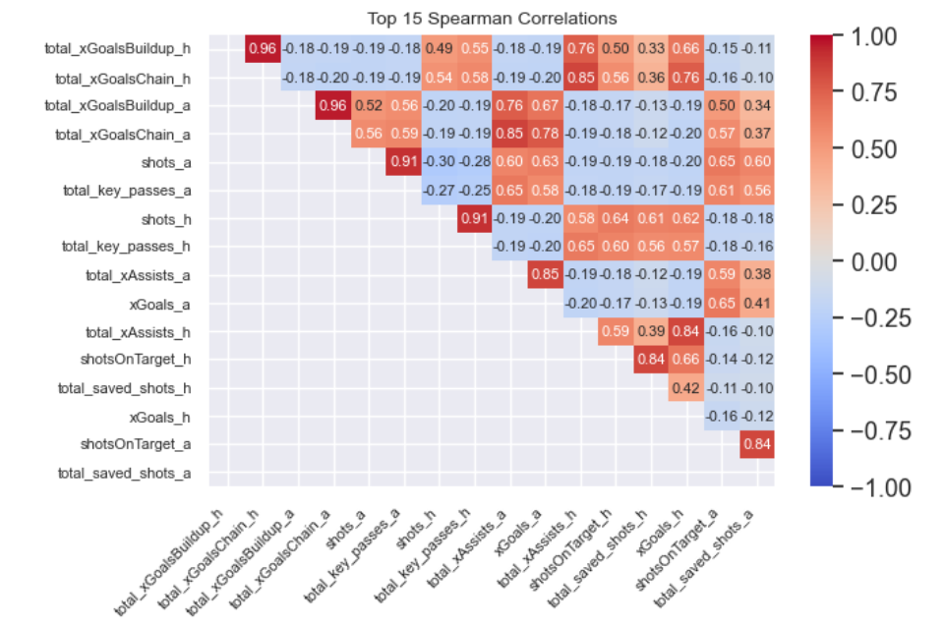
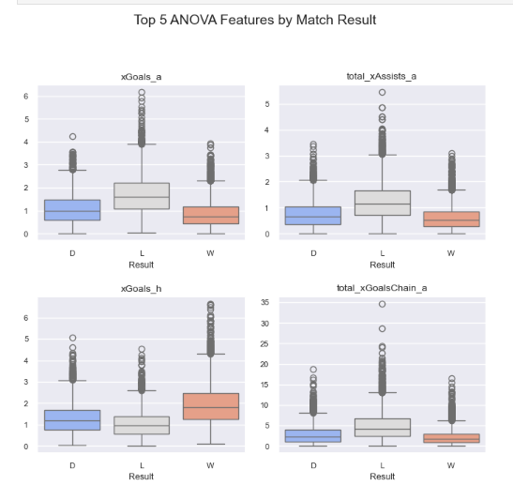
3. Exploratory Data Analysis (EDA)
Performance Drive Results (How well team played)
- Goals, assists, and xG strongly linked to wins
- High pass accuracy and shots on target = better outcomes
- Top ANOVA features: goals_scored, shots_on_target
Disciplinary Factors Matter
(The player behavior)
- More red cards → higher chance of losing
- Strong significance (p < 0.001)
- Discipline is critical to match results
Match Statistics Patterns (Data patterns)
- Most features are right-skewed
- Strong correlations: possession ↔ passes
Home wins dominate

Slide 6
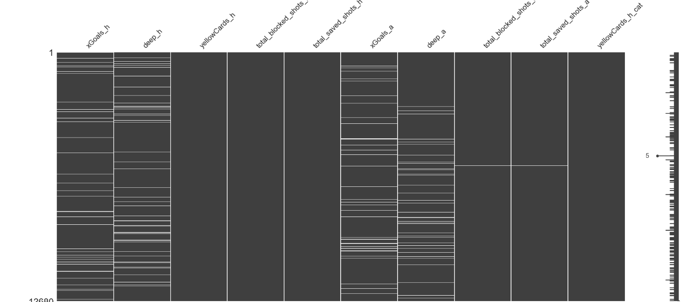
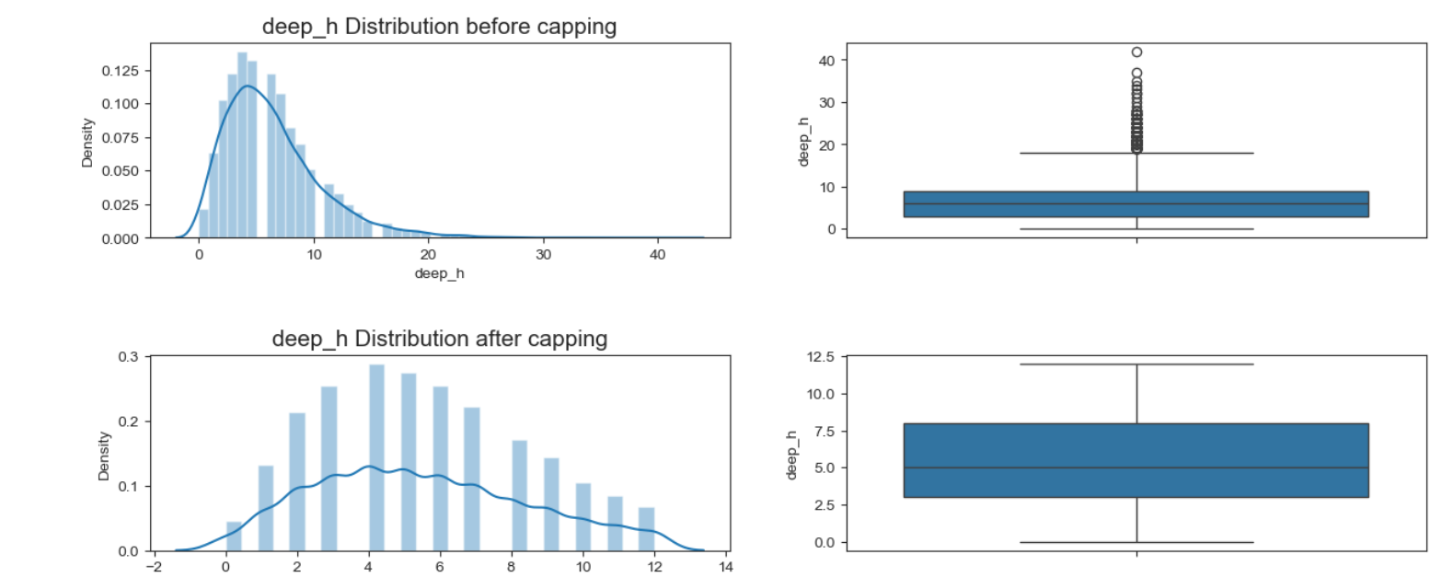
4. Outliers, Missing Data and Feature Engineering
feature | distribution_ changed | correlation_ changed | drop | feature | distribution_ changed | correlation_ changed | drop
awayGoals | + | + | no | shotsOnTarget_a | + | + | no
awayGoalsHT_cat | + | + | no | shotsOnTarget_h | + | + | no
awayGoalsHalfTime | + | + | no | shots_a | + | + | no
awayGoals_cat | - | - | yes | shots_h | + | + | no
corners_a | + | - | yes | teamgoals_a | + | + | no
corners_h | + | - | yes | teamgoals_h | + | + | no
deep_a | - | + | yes | total_assists_a | + | + | no
deep_h | - | + | yes | total_assists_a_cat | + | + | no
fouls_a | + | - | yes | total_assists_h | + | + | no
fouls_h | + | - | yes | total_assists_h_cat | - | - | yes
game_day | - | - | yes | total_blocked_shots_a | - | - | yes
game_month | - | - | yes | total_blocked_shots_h | - | - | yes
game_year | - | - | yes | total_key_passes_a | + | + | no
homeGoals | + | + | no | total_key_passes_h | + | + | no
homeGoalsHT_cat | + | + | no | total_saved_shots_a | - | - | yes
homeGoalsHalfTime | + | + | no | total_saved_shots_h | - | + | yes
homeGoals_cat | + | + | no | total_xAssists_a | + | + | no
leagueID | - | - | yes | total_xAssists_h | + | + | no
ownGoals_a | + | - | yes | total_xGoalsBuildup_a | + | + | no
ownGoals_a_cat | + | - | yes | total_xGoalsBuildup_h | + | + | no
ownGoals_h | + | - | yes | total_xGoalsChain_a | + | + | no
ownGoals_h_cat | + | - | yes | total_xGoalsChain_h | + | + | no
ppda_a | + | + | no | xGoals_a | - | + | yes
ppda_h | + | + | no | xGoals_h | - | + | yes
redCards_a | + | - | yes | yellowCards_a | + | - | yes
redCards_a_cat | + | - | yes | yellowCards_a_cat | - | - | yes
redCards_h | + | - | yes | yellowCards_h | - | - | yes
redCards_h_cat | + | - | yes | yellowCards_h_cat | - | - | yes
season | - | - | yes

Slide 7
4. Outliers, Missing Data and Feature Engineering
Created new features derived from player and team performance metrics, including:
goal_difference, xGoals_chain, xAssists_total, and others.
Rolling of average 5 years or ratio calculation
home_xGoals_h_rolling5 or home_win_rate_5 (wining ration in last 5 games)

Slide 8
4. Model Selection & Training
Models: Logistic Regression Decision Tree Random Forest AdaBoost Gradient Boosting XGBoost SVM Extra Trees.
Used train-test split (80-20%).
Fine Tuning

Slide 9
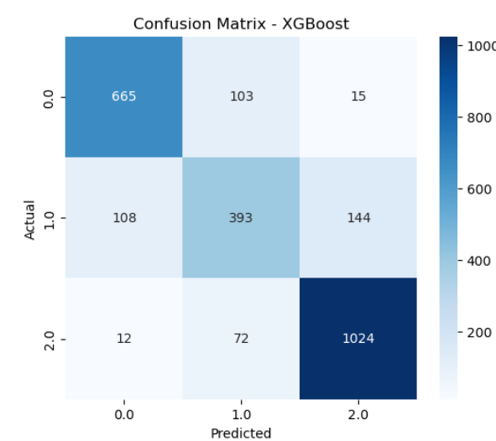
5. Model Evaluation

Slide 10
5. Model Evaluation
Best Parameters: {'subsample': 0.9, 'n_estimators': 300, 'max_depth': 7, 'learning_rate': 0.05, 'gamma': 1, 'colsample_bytree': 0.7}

Slide 11
6. Conclusion & Model Deployment
Key predictors: total_assists, Shots on Target, total_saved_shots , xGoals
Model: XGBoost Accuracy: 82%
Precision: 80%; Recall: 79%
Useful data driven for sports analytics and game predictions, Coaches, sports scientists, media and fans.
Future Work: Add player form, weather conditions, Try deep learning models for better predictions

Slide 12
Alternative Model – prediction Before The Game (historical data)
Still Beter then 0.33

Slide 13
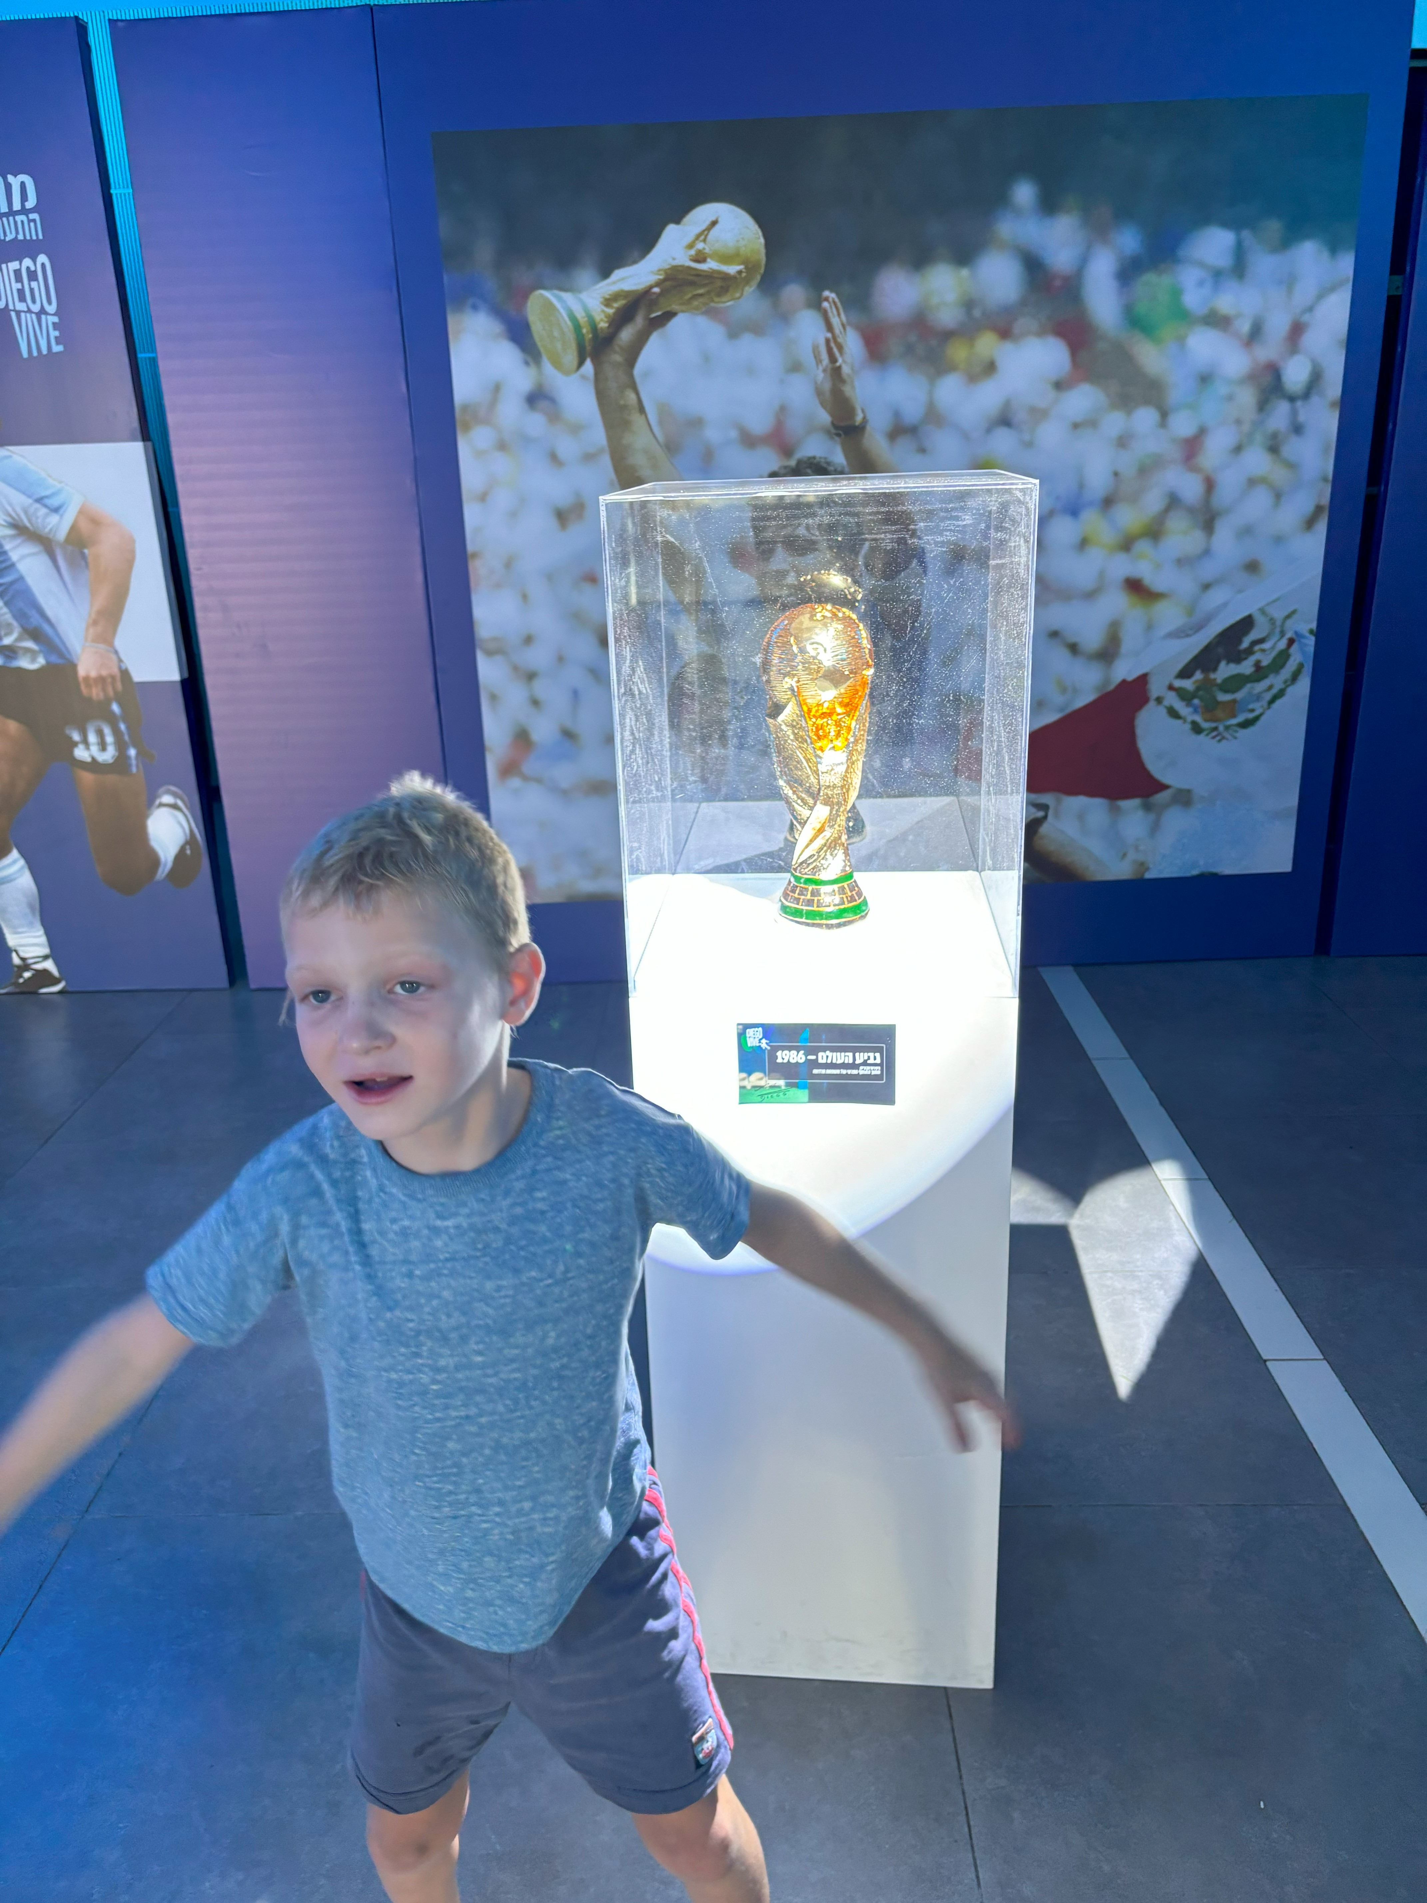
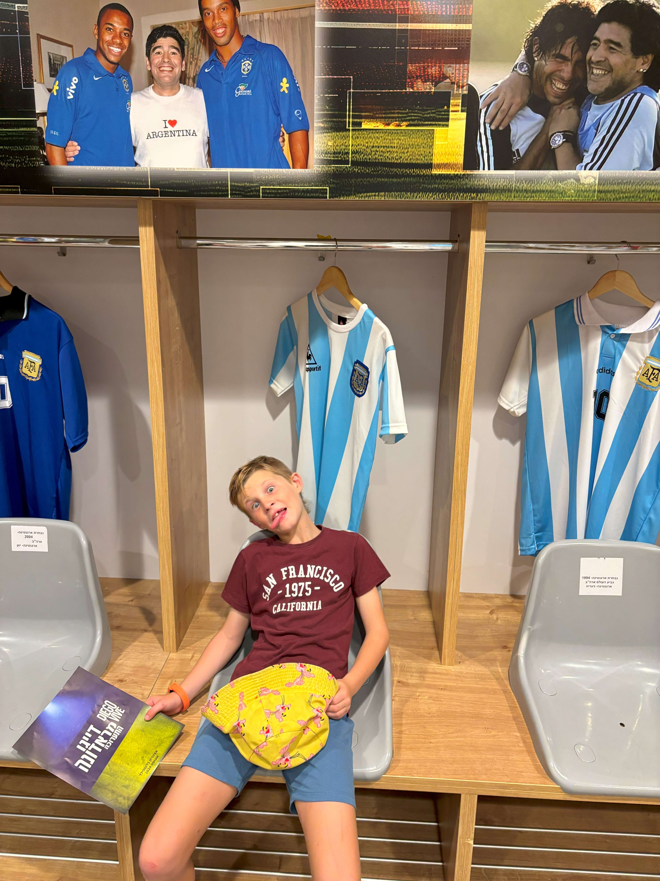
Q&A

